Slide 1
Term Project Proposal
Team 3
Ilhyun Suh
Liping Guan

Slide 2
Introduction
Aggregation is one of the most common workload for database systems
In SimpleDB, aggregation is already implemented based on MergeSort (external sort)

Slide 3
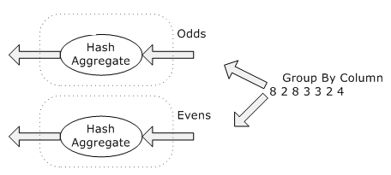
Introduction
Other aggregation algorithms
Hash aggregation

Slide 4
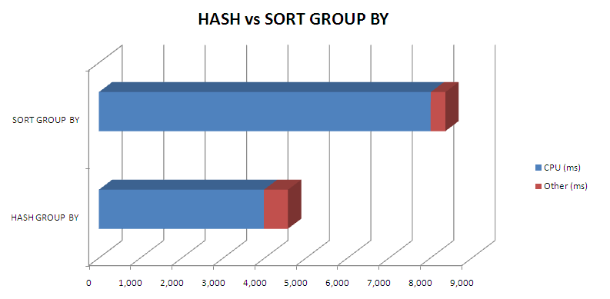
Introduction
According to the performance evaluation of Oracle, the HASH GROUP BY outperforms the SORT GROUP BY
Input : 2.5 millions rows
Output : about 200,000 rows

Slide 5
Introduction
SORT GROUP BY has a side effect
The output is sorted by the grouping attributes
Best to use SORT GROUP BY when the SQL requests an ORDER BY as well as the GROUP BY
Is this always true?

Slide 6
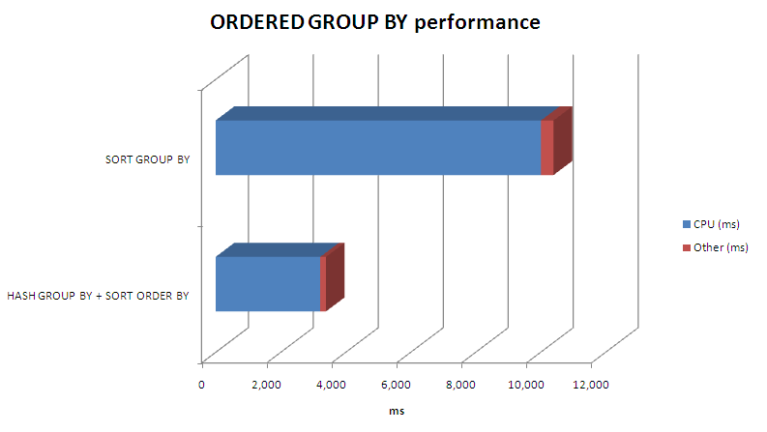
Introduction
If the output result is small, performing additional sort after GROUPing BY the input is much more efficient
Input : 2.5 millions rows
Output : about 200,000 rows

Slide 7
Project Proposal
Compare the two aggregation algorithms
SORT GROUP BY
HASH GROUP BY
Plans
We evaluate the performance by varying the number of output
We evaluate the performance of GROUP BY along with ORDER BY with two algorithms
SORT GROUP BY
HASH GROUP BY + SORTING

Slide 8
Project Proposal (to-do)
Make data sets for experiments
Implement the HASH GROUP BY
Must consider the number of available buffers and spilling the hash table into disk in case of overflow
Implment the MultiBufferSort for SORT GROUP BY

Slide 9
QnA
Thank you!

